Slide 1
Responsible AI

Slide 2

Applied Ethics
Applying ethics to real-world situations
https://ethicsunwrapped.utexas.edu/glossary/applied-ethics

Slide 3

Embedded values
https://www.bloomberg.com/news/articles/2017-07-09/robert-moses-and-his-racist-parkway-explained

Slide 4
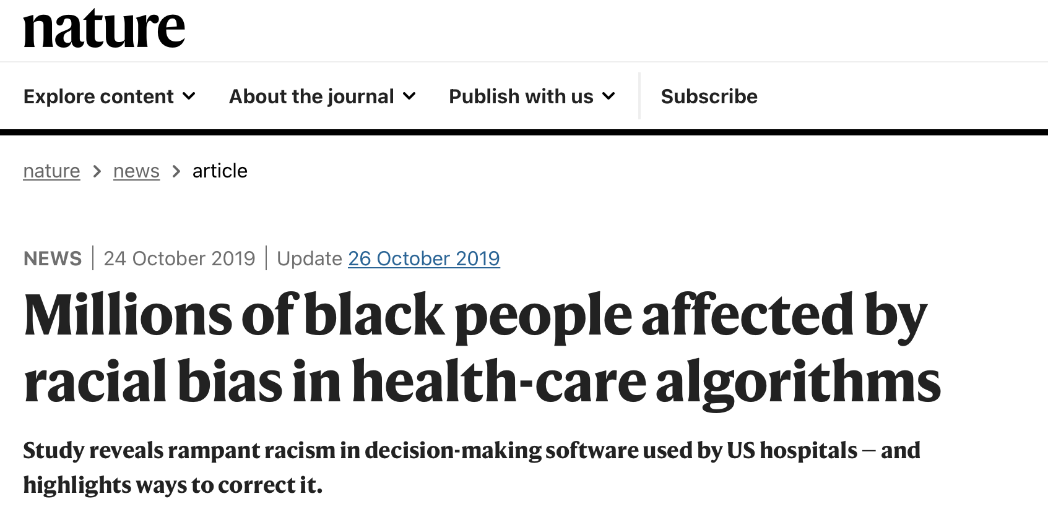

Bias
https://www.nytimes.com/2016/06/26/opinion/sunday/artificial-intelligences-white-guy-problem.html

Slide 5


Impacting ethical values
Inadvertently
Purposely

Slide 6
Methods to address ethical issues
Ex-ante
Intra
Ex-post
Before research and innovation
During Research and development
Existing technologies

Slide 7
Ex-ante methods
Ex-ante
Intra
Ex-post
Before research and innovation
identify potential emerging technologies and their characteristics and defining features.
construct scenarios about future ethical impacts.
evaluate the likelihood and significance of potential ethical impacts.
assess and address the status of uncertain normative claim.

Slide 8
Intra methods
Ex-ante
Intra
Ex-post
During Research and development
disclose ethical issues in design
how values are embedded in technology design
organise the process of “practising ethics”.

Slide 9
Ex-post methods
Ex-ante
Intra
Ex-post
Existing technologies
Help identify and address end-users with addressing ethical issues;
Ethical issues raised by existing technologies;
Support ethical decision-making

Slide 10
Ethical impact assessment
Ex-ante
Intra
Ex-post
During Research and development
New and emerging technologies often raise both ethical and privacy issues. The analysis and assessment of such issues is the task of ethical impact assessments. The EIA can be used to advance responsible research and innovation.

Slide 11
Benefits of ethical impact assessment
Ex-ante
Intra
Ex-post
an early warning system;
unearth valuable insights and hidden assumptions about the technology;
gain the public’s trust and confidence that privacy has been built into the design of a project, technology or service;
demonstrate to employees and contractors that it takes privacy seriously and expects them to do so too; and
demonstrates to customers and/or citizens that it respects their privacy and is responsive to their concerns.

Slide 12
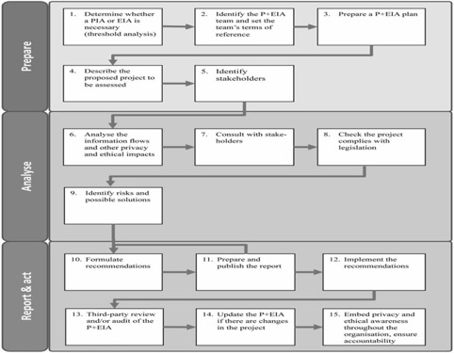
Steps of an ethical impact assessment
Ex-ante
Intra
Ex-post

Slide 13
Challenges to conduct
Ex-ante
Intra
Ex-post
Finding the right people
Identifying and operationalising criteria against which to measure the privacy and ethical impacts
Engaging different stakeholders in the process is a challenge.
Identifying impacts and risks is a challenge. Technologies may have intended as well as unintended con- sequences.
Finding and encouraging stakeholders to participate in consultation exercises.

Slide 14
Any Questions?

